Slide 1

EDA PROJECT- ANALYSIS ON AMCAT DATA

Slide 2
About me
I am a B-tech graduate majoring in mechanical engineering.
As we know that data is everywhere and everything. I am interested in working with data.
I agree that I have lack of work experience but I believe that analytical skills from educational background and skills I have developed strong fit to the role. I am passionate about extracting meaningful insights from data and I am eagerly waiting to contribute my work.
Linkedin: www.linkedin.com/in/shaziya-naaz-neen
Github : https://github.com/shaziyanaazneen

Slide 3
Agenda (This should be the PPT flow)
Business Problem and Use case domain understanding: The project main objective is to analyse the data and illustrate meaningful insights from data to make data-driven decisions.
Objective of the Project: The objective of the project is to perform data analysis, data manipulation and draw data driven decisions using data driven techniques like
Univariate analysis: a) categorical
b) numerical
Bivariate analysis: a)categorical-categorical
b)categorical-numerical c)numerical-numerical

Slide 4
SUMMARY OF THE DATA:
There are 38 columns and 3998 rows
collegeCityID -int
Collegetier -int
Collegestate -object
Graduationyear -int
English -int
Logical -int
Quant -int
Domain -float
Computerprogramming -int
Electronicsandsemicon -int
Computerscience -int
Mechanicalengineering -int
Telecomengineering -int
Civilengineering -int
Conscientiousness -float
Agreebleness -float
Extraversion -float
Nueroticism -float
Openess_to_experience -float
ID -int
Salary -int
DOJ -datetime
DOL -object
Designation -object
JobCity -object
Gender -object
DOB -datetime
10percentage -float
10board -object
12graduation -int
12percentage -float
12board -object
CollegeId -int
CollegeTier -int
Degree -object
Specialization -object
collegeGPA -float

Slide 5
Exploratory data analysis
Data cleaning: It plays a major role in data analysis. I have cleaned the data accordingly and found the missing values and removed unwanted data. Found the data types of the columns.
Data manipulation: Manipulated the data to uncover the valuable insights from the data. Adjusting the data and making new columns or changing the data types and organising the data so that it makes easy to read.

Slide 6
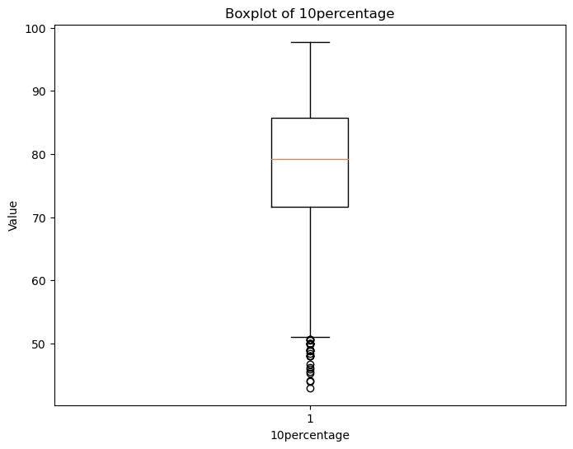
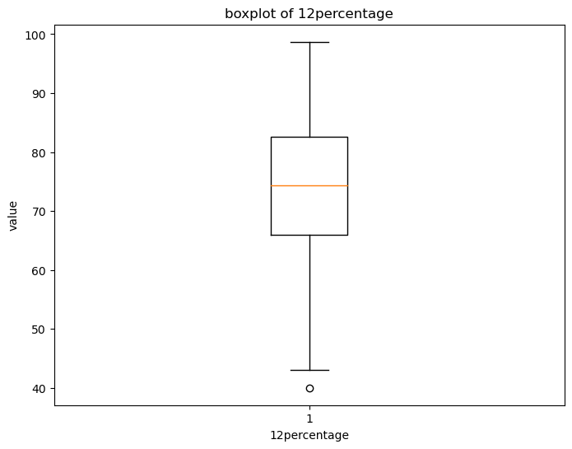
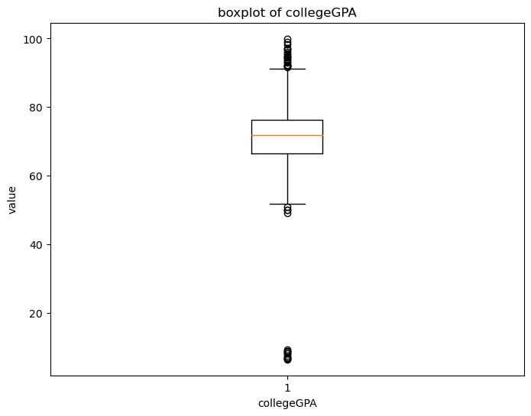
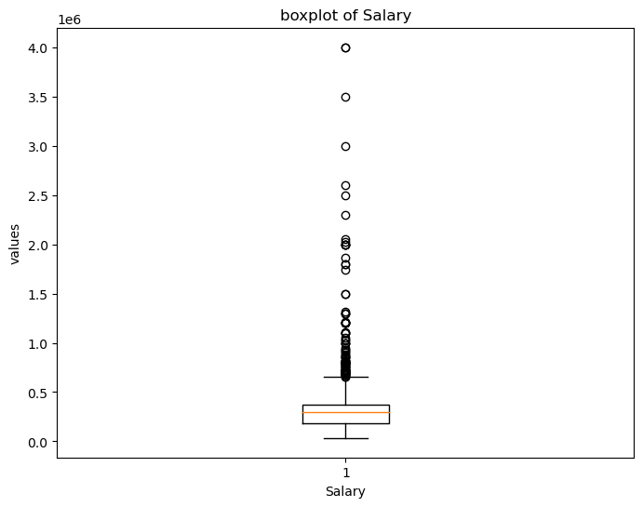
UNIVARIATE ANALYSIS:
For example: Boxplots of 10percentage, 12percentage, collegeGPA, salary

Slide 7
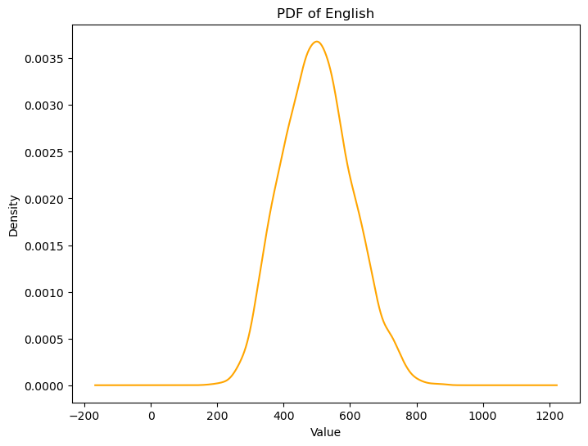
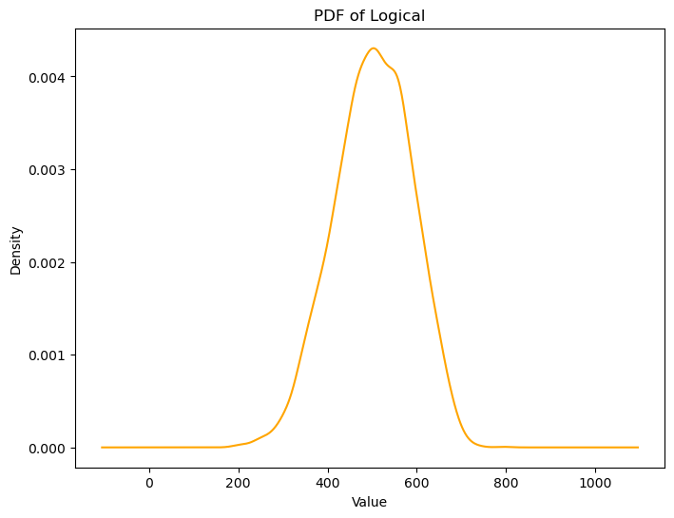
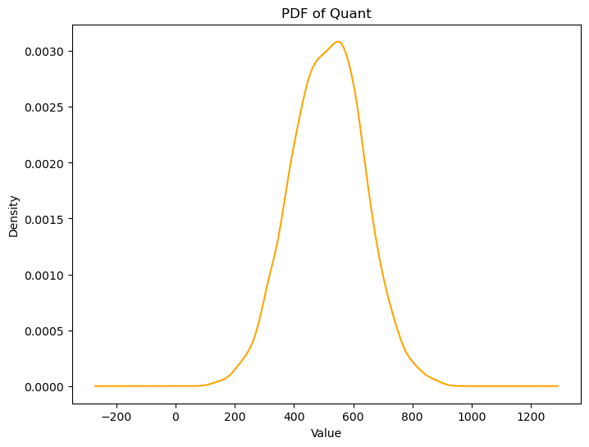
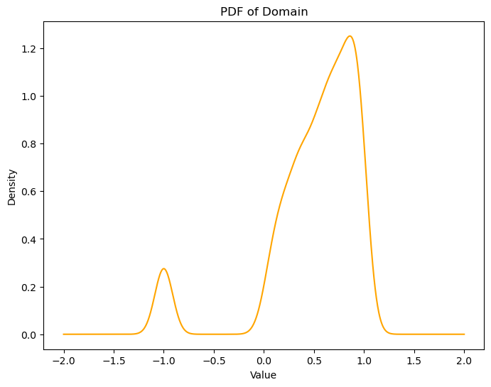
Probability frequency distribution of each numerical column:
For example: pdf of English, logical, quant, and domain.

Slide 8
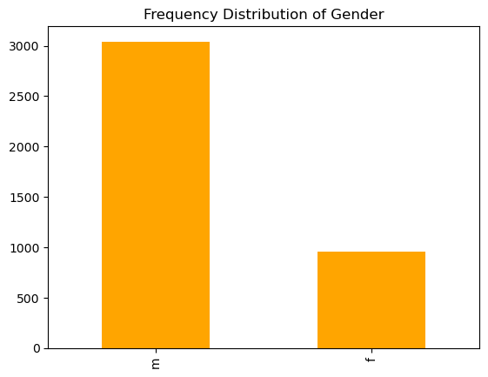
Frequency of categorical/ numerical column:
For example: frequency distribution of gender.

Slide 9
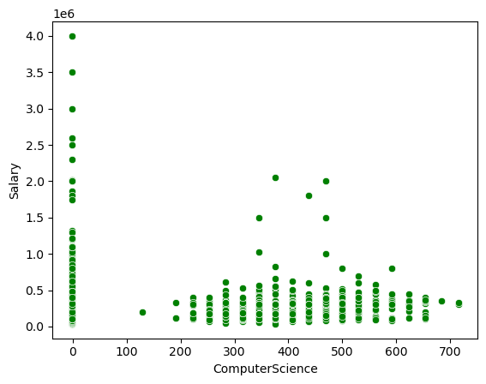
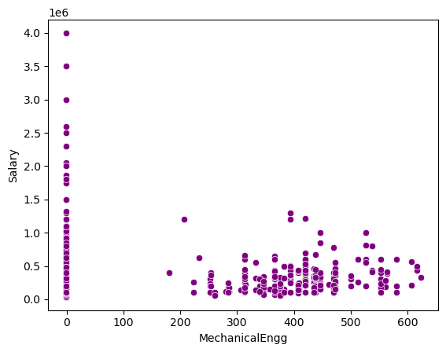
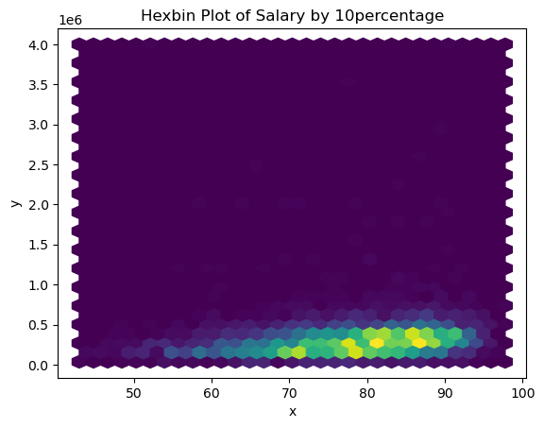
BIVARIATE ANALYSIS
Identified relationship between numerical columns using scatterplot and hexbin plot.
For example: scatterplots between computerscience and salary, mechanical engineering and salary, and hexbin plot between salary by 10th percentage.

Slide 10
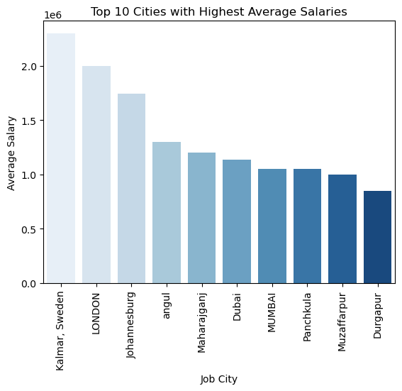
Patterns between categorical and numerical column using barplot:

Slide 11
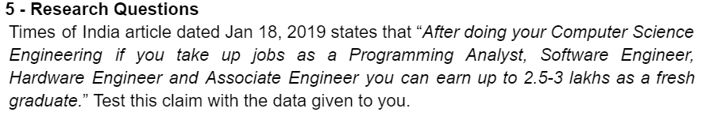
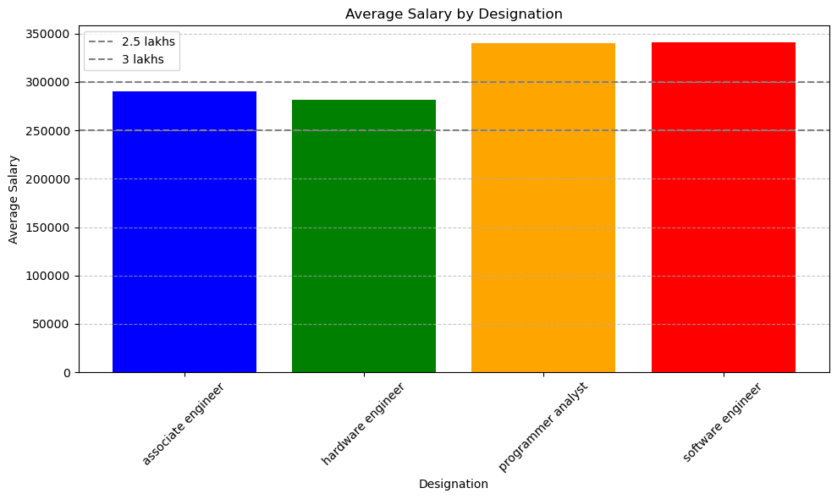
Research question:

Slide 12
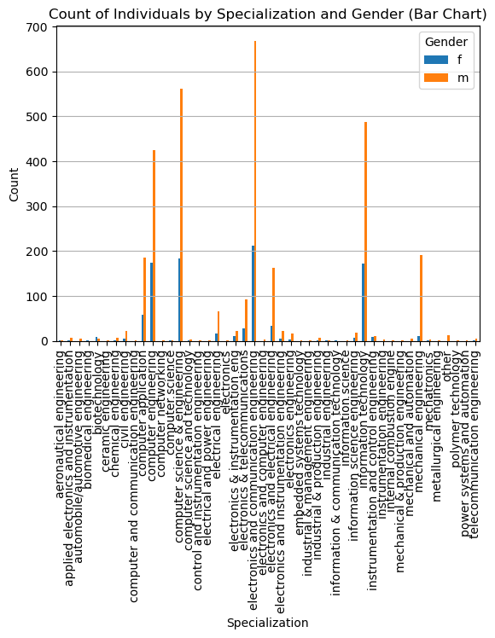
Research question-2:
Is there a relationship between gender and specialization? (i.e. Does the preference of Specialization depend on the Gender?)

Slide 13
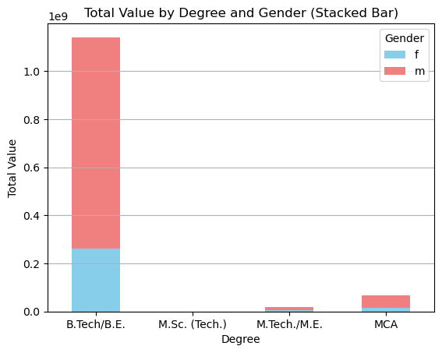
My research question 1: relationship between degree and gender

Slide 14
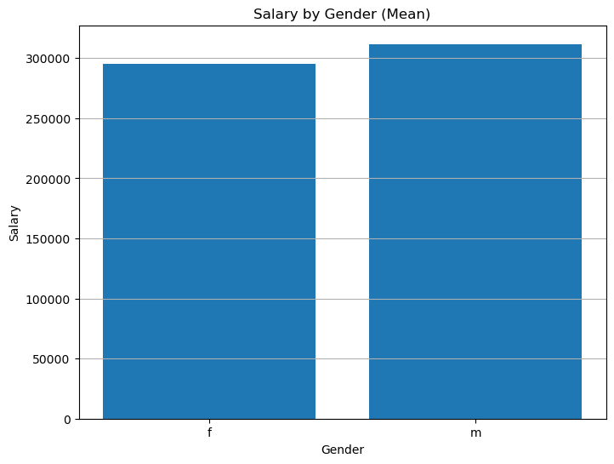
My research question 2: relationship between salary and gender.

Slide 15
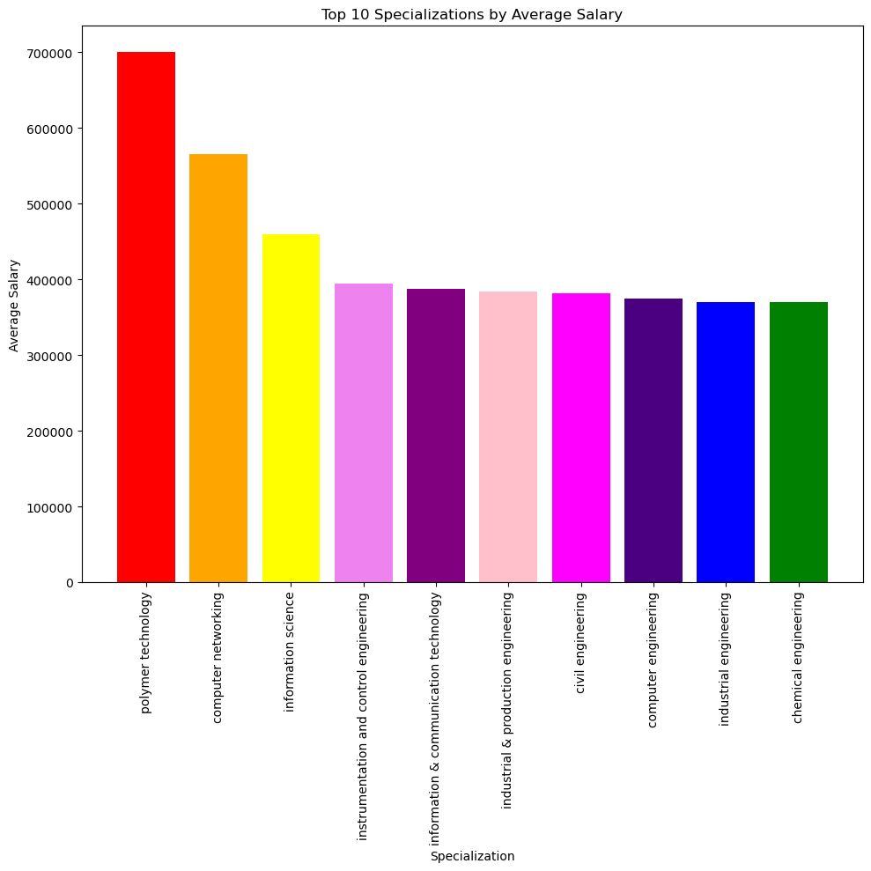
My research question 3:
Specializations by average salary

Slide 16
CONCLUSIONS:
I can draw a conclusion that after doing computer science engineering if we take up jobs in programmer analyst and software engineer the average salary is around 3-3.5 lakhs per annum.
Identified that electronics and communication specialization contribute more male and female students.
Extracted a insight where in relation between degree and gender, B-tech specialization contributes more females and males.
Developed a relation between specialization and average salary, and noticed that specialization in polymer technology have the highest average salary.
Average salary of females is comparatively less than males.

Slide 17

THANK YOU

